Slide 1

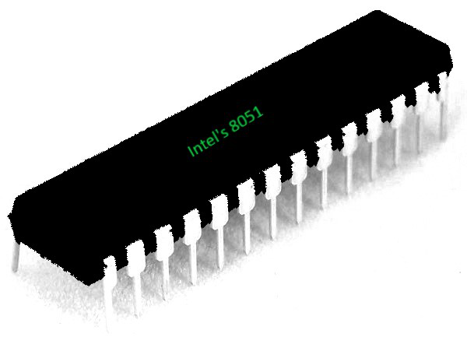
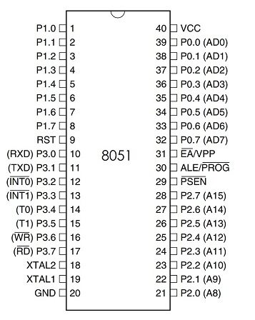
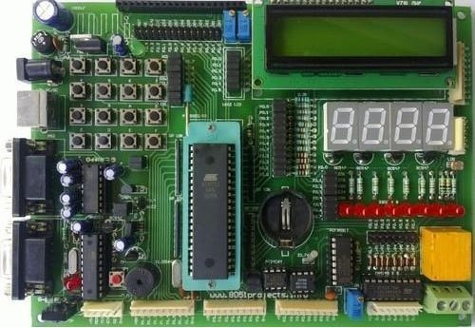
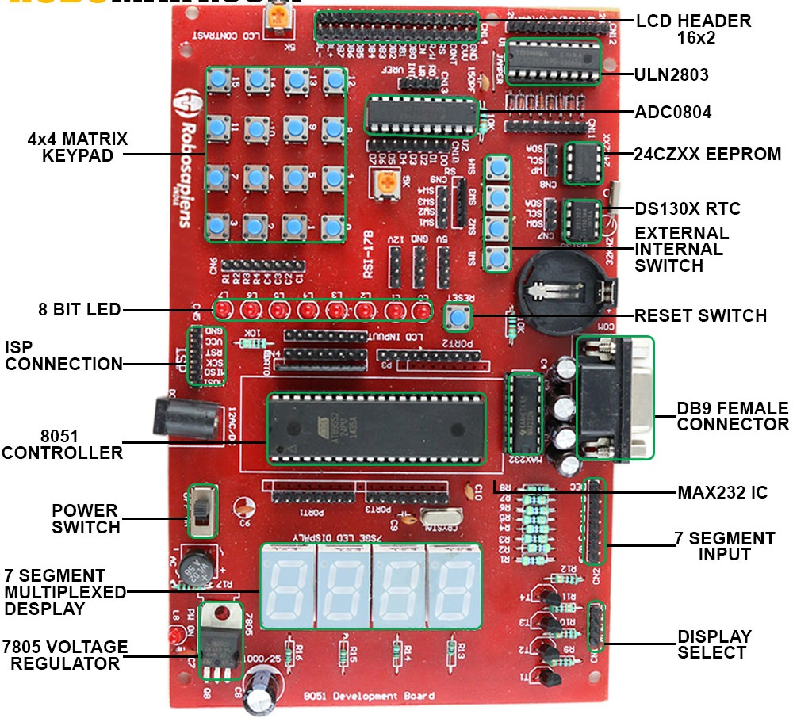
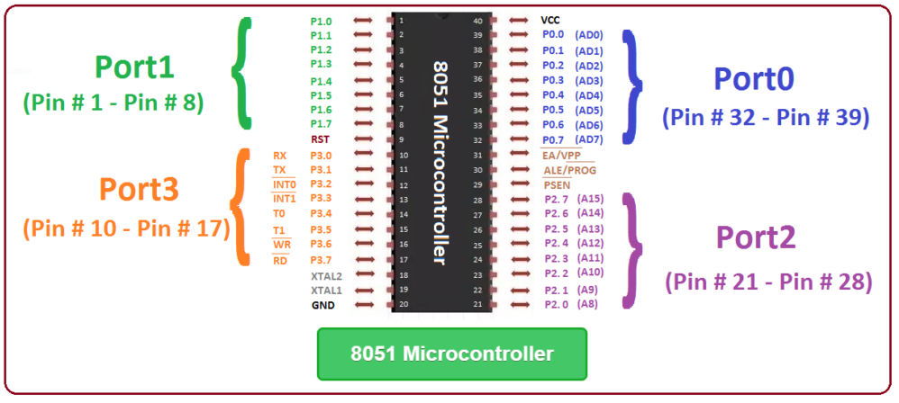
Micro Controller 2.4 8051 - SFRs, Addressing Modes FY – DESH – VIT
Vishwakarma Institute of Technology
FY - Department of Engineering, Sciences and Humanities

Slide 2
8051 Microcontroller Special function registers SFRs
Vishwakarma Institute of Technology
FY - Department of Engineering, Sciences and Humanities

Slide 3
Special Function Registers (SFRs)
In 8051 microcontroller there are certain registers which use the RAM addresses from 80H to FFH and they are meant for certain specific operations. (Upper 128 bytes).
These registers are called Special function registers (SFRs).
Some of these registers are bit and byte addressable.
Some of SFRs are related to I/O ports (P0,P1,P2 and P3) and some are meant for control operations (TCON,SCON, PCON..) and remaining are the auxiliary SFRs.
SFRs Memory addresses are only direct addressable. Even though some of the addresses between 80H and FFH are not assigned to any SFR, they cannot be used as additional RAM area.
Out of these 128 Memory Locations (80H to FFH), there are only 21 locations that are actually assigned to SFRs.
Each SFR has one Byte Address and also a unique name which specifies its purpose. Since the SFRs are a part of the Internal RAM Structure, you can access SFRs as if you access the Internal RAM.
Vishwakarma Institute of Technology
FY - Department of Engineering, Sciences and Humanities

Slide 4
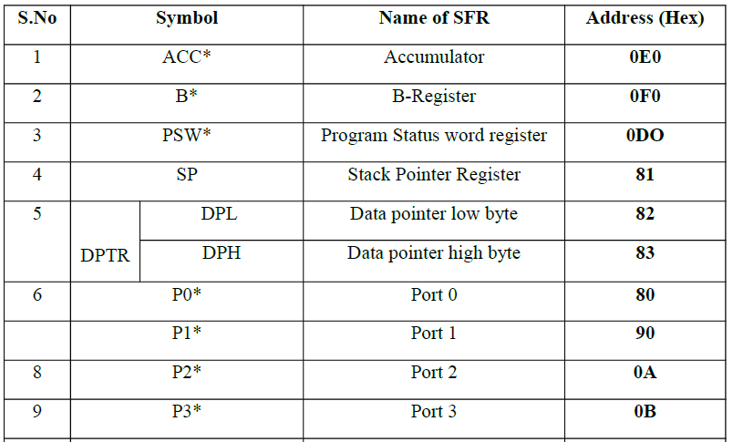
Special Function Registers (SFRs)
Vishwakarma Institute of Technology
FY - Department of Engineering, Sciences and Humanities
0A0
0B0
* Marked registers are bit and byte addressable, other registers are only byte addressable

Slide 5
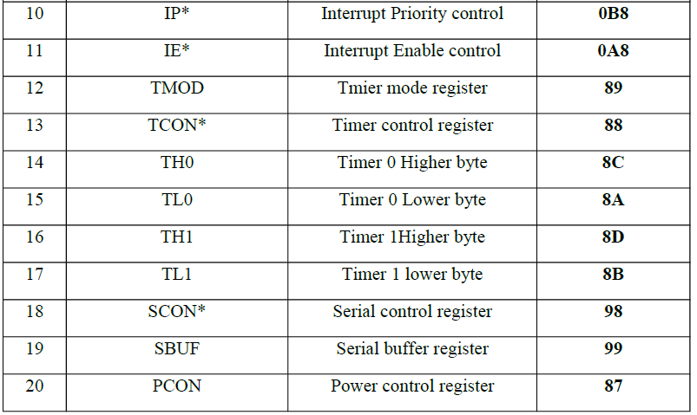
Special Function Registers (SFRs)
Vishwakarma Institute of Technology
FY - Department of Engineering, Sciences and Humanities
* Marked registers are bit and byte addressable, other registers are only byte addressable

Slide 6
1. SFR Register --Accumulator or A
ACC.7 ACC.6 ACC.5 ACC.4 ACC.3 ACC.2 ACC.1 ACC.0
Bit7 | Bit6 | Bit5 | Bit4 | Bit3 | Bit2 | Bit1 | Bit0
0E0H
E7 E6 E5 E4 E3 E2 E1 E0
The most important of all special function register is accumulator which is also known as ACC or A.
The Accumulator holds the result of most of arithmetic and logic operations.
To access the first bit (bit 0) or to access accumulator as a single byte (all 8 bits at once), A is accessed by direct addressing and its physical address is E0H.
Accumulator is both byte and bit addressable. If you want to access the second bit (bit 1), you may use E1H and for third bit E2H and so on.
Vishwakarma Institute of Technology
FY - Department of Engineering, Sciences and Humanities

Slide 7
2. SFR--Register B: F0H
B.7 B.6 B.5 B.4 B.3 B.2 B.1 B.0
Bit7 | Bit6 | Bit5 | Bit4 | Bit3 | Bit2 | Bit1 | Bit0
0F0H
F7 F6 F5 F4 F3 F2 F1 F0
Bit and byte addressable
The major purpose of this register is in executing multiplication and division.
The 8051 micro controller has a single instruction for multiplication (MUL) and division (DIV). Ex: MUL A,B – When this instruction is executed, data inside A and data inside B is multiplied and answer is stored in A.
Note: For MUL and DIV instructions, it is necessary that the two operands must be in A and B. Register B is also byte addressable and bit addressable. To access bit o or to access all 8 bits (as a single byte), physical address F0 is used. To access bit 1 you may use F1 and so on.
Vishwakarma Institute of Technology
FY - Department of Engineering, Sciences and Humanities

Slide 8
3. Stack Pointer SP: 81H
Bit7 | Bit6 | Bit5 | Bit4 | Bit3 | Bit2 | Bit1 | Bit0
81H
Stack pointer represents a pointer to the system stack.
Stack pointer is an 8 bit register, the direct address of SP is 81H and it is only byte addressable, which means you cannot access individual bits of stack pointer.
The content of the stack pointer points to the last stored location of system stack. To store something new in system stack, the SP must be incremented by 1 first and then execute the “store” command.
Usually after a system reset SP is initialized as 07H and data can be stored to stack from 08H onwards. This is usually a default case and programmer can alter values of SP to suit his/her needs.
Vishwakarma Institute of Technology
FY - Department of Engineering, Sciences and Humanities

Slide 9
4. Program Status Word (PSW): D0H
PSW.7 PSW.6 PSW.5 PSW.4 PSW.3 PSW.2 PSW.1 PSW.0
CY | AC | F0 | RS1 | RS0 | OV | -- | P
0D0H
D7 D6 D5 D4 D3 D2 D1 D0
Carry flag Parity flag
Auxiliary Carry Flag User definable flag
General purpose status flag Overflow flag
Register bank select bit1 Register bank select0
Vishwakarma Institute of Technology
FY - Department of Engineering, Sciences and Humanities
This is a vital SFR in the functioning of micro controller.
This register reflects the status of the operation that is being carried out in the processor.
PSW Register is both bit and byte addressable. The physical address of PSW starts from D0H. The individual bits are then accessed using D1, D2 … D7.

Slide 10
4. Program Status Word (PSW)
Bit No | Bit Symbol | Direct Address | Name | Function
0 | P | D0 | Parity | This bit will be set if ACC has odd number of 1’s after an operation. If not, bit will remain cleared.
1 | – | D1 |  | User definable bit
2 | OV | D2 | Overflow | OV flag is set if there is a carry from bit 6 for signed number operation, but not from bit 7 of an Arithmetic operation.
3 | RS0 | D3 | Register Bank select | LSB of the register bank select bit. Bit 0
4 | RS1 | D4 | Register Bank select | MSB of the register bank select bits. Bit 1
5 | F0 | D5 | Flag 0 | User defined flag
6 | AC | D6 | Auxiliary carry | This bit is set if data is coming out from bit 3 to bit 4 of Acc during an Arithmetic operation.
7 | CY | D7 | Carry | Is set if data is coming out of bit 7 of Acc during an Arithmetic operation.
Vishwakarma Institute of Technology
FY - Department of Engineering, Sciences and Humanities

Slide 11
4. Program Status Word (PSW)
The selection of the register Banks in PSW and their addresses
RS1 | RS0 | Register Bank | Address
0 | 0 | Bank 0 | 00H-07H
0 | 1 | Bank 1 | 08H-0FH
1 | 0 | Bank 2 | 10H-17H
1 | 1 | Bank 3 | 18H-1FH
Vishwakarma Institute of Technology
FY - Department of Engineering, Sciences and Humanities
CY -- Carry flag
This flag is set whenever there is a carry out from the D7 bit. This flag bit is affected after an 8-bit addition or subtraction. It can also be set to 1 or 0 directly by an instruction such as “SETB C” and “CLR C” where “SETB C” stands for “set bit carry” and “CLR C” for “clear carry”.
AC -- Auxiliary carry flag
If there is a carry from D3 to D4 during an ADD or SUB operation, this bit is set; otherwise, it is cleared. This flag is used by instructions that perform BCD (binary coded decimal) arithmetic.

Slide 12
4. Program Status Word (PSW)
P -- Parity flag
The parity flag reflects the number of 1 s in the A (accumulator) register only. If the A register contains an odd number of Is, then P = 1. Therefore, P = 0 if A has an even number of Is.
OV -- Overflow flag
This flag is set whenever the result of a signed number operation is large, causing the high-order bit to overflow into the sign bit. In general, the carry flag is used to detect errors in unsigned arithmetic operations. The overflow flag is only used to detect errors in signed arithmetic operations
Vishwakarma Institute of Technology
FY - Department of Engineering, Sciences and Humanities

Slide 13
4. Program Status Word (PSW)
Impact of the ADD instruction on the flag bits CY, AC, and P of the PSW register.
1. MOV A, #38H 0011 1000
ADD A, # 2FH 0010 1111
0110 0111
CY = 0, AC = 1, P = 1 as ACC has five 1’s
2. MOV A, # 9CH 1001 1100
ADD A, # 64H 0110 0100
1 0000 0000
CY = 1, AC = 1, P = 0 as ACC has zero 1’s
3. MOV A, #88H 1000 1000
ADD A, #93H 1001 0011
1 0001 1011
CY = 1, AC = 0, P = 0 as ACC has four 1’s
Vishwakarma Institute of Technology
FY - Department of Engineering, Sciences and Humanities

Slide 14
Port --8051 internal I/O ports
P0, P1, P2 and P3 are byte addresses used to access and perform read or write or other operations
Direct 8-bit addresses of each are specified in the instructions
Addresses of bytes at P0– 080, Floating pins
P1– 090, Internal Pull-ups
P2– 0A0 and, Internal Pull-ups
P3─ 0B0. Internal Pull-ups
True Bidirectional
Quasi Bidirectional
Vishwakarma Institute of Technology
FY - Department of Engineering, Sciences and Humanities
The difference between the quasi-bidirectional port and the true bidirectional port
There is no pull-up resistor inside the bidirectional P0 port. It is true bidirectional.
Others are quasi… quasi-bidirectional I/O is a type of input-output port on an integrated circuit such as a PIA. It can be used as an input or output without the use of a control signal for data direction. At power-on the I/Os are HIGH.
A Peripheral Interface Adapter (PIA) is a peripheral integrated circuit providing parallel I/O interfacing for microprocessor systems. Ex IC 8255

Slide 15
5. Port 0 and Register P0 – 80H
P0.7 P0.6 P0.5 P0.4 P0.3 P0.2 P0.1 P0.0
Bit7 | Bit6 | Bit5 | Bit4 | Bit3 | Bit2 | Bit1 | Bit0
80H
87 86 85 84 83 82 81 80
P0 includes pins (32-39). It is an I/O port with some alternative functions.
When the external memory is used with microcontroller, then the lower address byte (addresses A0-A7) is applied on P0.
This is an open drain port. Open drain term is used for CMOS versions while, open collector term is used for TTL versions.
If external memory is not used, all bits of P0 are configured for I/O purposes.
P0 doesn’t contain built-in pull-up resistors. It is true bidirectional port.
Each pin must be connected to external pull up resistors of 10K, if port is to be used as I/O.
P0 Register is both bit and byte addressable.
Vishwakarma Institute of Technology
FY - Department of Engineering, Sciences and Humanities
15

Slide 16
6. Port 1 and Register P1 : 90H
P1.7 P1.6 P1.5 P1.4 P1.3 P1.2 P1.1 P1.0
Bit7 | Bit6 | Bit5 | Bit4 | Bit3 | Bit2 | Bit1 | Bit0
90H
97 96 95 94 93 92 91 90
Port 1 is a dedicated I/O port from pin 1 to pin 8.
It is generally used for interfacing to external device like LED, sensors, switches, motors etc.
Port pins are internally pulled up. As an I/O port: Standard quasi-bidirectional.
P1 is a true I/O port as it doesn’t have any alternative functions as in P0. It has a built-in pull-up resistors.
Writing 1 to each bit of a port configures that port as input while writing zero configures that as output. By default, port is configured as input on power-on.
P1 Register is both bit and byte addressable.
Vishwakarma Institute of Technology
FY - Department of Engineering, Sciences and Humanities

Slide 17
7. Port 2 and Register P2 -- A0 H
P2.7 P2.6 P2.5 P2.4 P2.3 P2.2 P2.1 P2.0
Bit7 | Bit6 | Bit5 | Bit4 | Bit3 | Bit2 | Bit1 | Bit0
A0H
A7 A6 A5 A4 A3 A2 A1 A0
Like port 0, port 2 is a dual-purpose port.(Pins 21 through 28)
Like P1 ,Port 2 also doesn’t require any pull-up resistors. As an I/O port: Standard quasi-bidirectional.
Alternate functions: High byte of address bus for external program and data memory accesses.
Writing 1 to each bit of a port configures that port as input while writing zero configures that as output. By default, port is configured as input on power-on
Register is both bit and byte addressable.
Vishwakarma Institute of Technology
FY - Department of Engineering, Sciences and Humanities

Slide 18
8. Port 3 and Register P3– B0 H
P3.7 P3.6 P3.5 P3.4 P3.3 P3.2 P3.1 P3.0
RD | WR | T1 | T0 | INT1 | INT0 | TXD | RXD
B0H
B7 B6 B5 B4 B3 B2 B1 B0
Port 3 is also dual purpose but designers generally avoid using this port for I/O because the pins have alternate functions which are related to special features of the 8051. Use of these pins may interfere with the normal operation of the 8051.
As an I/O port: Standard quasi-bidirectional.
Alternate functions:
Serial I/O - TXD, RXD
Timer clocks- T0, T1
Interrupts - INT0, NT1
Data memory- RD, WR
Register is both bit and byte addressable.
Vishwakarma Institute of Technology
FY - Department of Engineering, Sciences and Humanities

Slide 19
Timer/Counters
Two 16-bit up counters, named T0 and T1, are provided for the general use
of the programmer.
Each counter may be programmed to count internal clock pulses, acting as a timer, or programmed to count external pulses as a counter.
The counters are divided into two 8-bit registers called the timer low (TL0,TL1) and high (TH0, TH1) bytes.
All counter action is controlled by bit states in the timer mode control register (TMOD), the timer/counter control register (TCON) and certain program instructions.
TMOD is dedicated to the two timers and can be considered as two 4-bit registers, each of which controls the action of the timers.
TCON has control bits and flags for the timers in the upper control nibble and flags for the external interrupts in the lower nibble.
Vishwakarma Institute of Technology
FY - Department of Engineering, Sciences and Humanities

Slide 20
Timer/Counters cont…..
These timers exist in the SFR area as pairs of 8- bit registers.
TL0 (8AH) and TH0 (8CH) for Timer0.
TL1 (8BH) and TH1 (8DH) for Timer1. (LSB is bit 0 ; MSB is bit 7)
When used as timers, the registers are incremented once per machine cycle. – Each machine cycle is 12 clock cycles.
Count frequency = (system clock frequency) / 12
When used as counters, the registers will be incremented once on every 1-0 (negative edge) on the appropriate input pin.
T0 – P3.4
T1 – P3.5
The pins must be held high for one complete machine cycle and then low for one complete machine cycle. Maximum count rate is 1/24 of the oscillator frequency.
Vishwakarma Institute of Technology
FY - Department of Engineering, Sciences and Humanities

Slide 21
Timer/Counters : comparison
Timer | Counter
1. The register incremented for every machine cycle. | 1. The register is incremented considering 1 to 0 transition at its corresponding external input pin (T0, T1).
2. Maximum count rate is 1/12 of the oscillator frequency. | 2. Maximum count rate is 1/24 of the oscillator frequency.
3. A timer uses the frequency of the internal clock, and generates delay. | 3. A counter uses an external signal to count pulses.
Vishwakarma Institute of Technology
FY - Department of Engineering, Sciences and Humanities

Slide 22
9. TCON (Timer Control Register): 88H
TCON.7 TCON.6 TCON.5 TCON.4 TCON.3 TCON.2 TCON.1 TCON.0
TF1 | TR1 | TF0 | TR0 | IE1 | IT1 | IE0 | IT0
088H
8F 8E 8D 8C 8B 8A 89 88
TF1, TF0 | TR1, TR0 | IE1, IE0 (Ext interrupt flags) | IT1, IT0 (External Interrupt Type)
Overflow flags for Timer 1 and Timer 0. | Run control bits for Timer1 and Timer0. Set to run, reset to hold. | Edge flag for external interrupts 1 and 0. Set by interrupt edge, cleared when interrupt is processed. | Type of Interrupts. Reset for 0 level interrupts and set for falling edge interrupts by software. When IT0=1 or IT1=1 It specifies interrupt on falling edge and when IT0=0 or IT1=0 it specifies low level interrupt .
Vishwakarma Institute of Technology
FY - Department of Engineering, Sciences and Humanities

Slide 23
10. TMOD (Timer Mode) Register: 089H
Gate | C/T | M1 | M0 | Gate | C/T | M1 | M0
089H
Timer 1
Timer 0
Both Timer 0 and Timer 1 use the same register to set the various timer operation modes. It is an 8-bit register in which the lower 4 bits are set aside for Timer 0 and the upper four bits for Timers.
In each case, the lower 2 bits are used to set the timer mode in advance and the upper 2 bits are used to specify the location.
Gate − Decides whether the timer starts with external interrupt or
with instructions.
C/T − Counter/Timer select bit.
M1 − Mode bit 1.
M0 − Mode bit 0.
Vishwakarma Institute of Technology
FY - Department of Engineering, Sciences and Humanities

Slide 24
10. TMOD (Timer Mode) Register: 089H
GATE | C/T | M1 | M0 | GATE | C/T | M1 | M0
089H
Timer 1
Timer 0
GATE = 0
The start and stop of a timer is controlled by software using the instruction
SETB TR1 and CLR TR1 for timer 1 and
SETB TR0 and CLR TR0 for timer 0.
The SETB instruction is used to start timer and CLR instruction is used to stop timer.
GATE= 1
Timers can be started and stopped by an external source.
Vishwakarma Institute of Technology
FY - Department of Engineering, Sciences and Humanities

Slide 25
10. TMOD (Timer Mode) Register: 089H
Gate | C/T | M1 | M0 | Gate | C/T | M1 | M0
089H
Timer 1
Timer 0
C/T (CLOCK / TIMER)
This bit in the TMOD register is used to decide whether a timer is used as a delay generator or an event manager.
If C/T = 0, it is used as a timer for timer delay generation. C/T =1 Counter
The clock source to create the time delay is the crystal frequency of the 8051. The crystal frequency also decides the speed at which the 8051 timer ticks at a regular interval.
Timer frequency is always 1/12th of the frequency of the crystal attached to the 8051.
Vishwakarma Institute of Technology
FY - Department of Engineering, Sciences and Humanities
25

Slide 26
10. TMOD—Different modes of timers
Gate | C/T | M1 | M0 | Gate | C/T | M1 | M0
089H
Timer 1
Timer 0
Mode Bits M1 and M0
Mode 0 (13-Bit Timer Mode)
Both Timer 1 and Timer 0 in Mode 0 operate as 13-bit counters.
Timer register is configured as a 13-bit register consisting of all the 8 bits of TH1 and the lower 5 bits of TL1. The upper 3 bits of TL1 are indeterminate and should be ignored. Setting the run flag (TR1) does not clear the register. The timer interrupt flag TF1 is set when the count rolls over from all 1s to all 0s. Mode 0 operation is the same for Timer 0 and for Timer 1.
M1 | M0 | Mode
0 | 0 | 13-bit timer mode
0 | 1 | 16bit timer mode
1 | 0 | 8-bit auto reload mode
1 | 1 | Split mode
Vishwakarma Institute of Technology
FY - Department of Engineering, Sciences and Humanities
26

Slide 27
10. TMOD—Different modes of timers
Gate | C/T | M1 | M0 | Gate | C/T | M1 | M0
089H
Timer 1
Timer 0
Mode Bits M1 and M0
Mode 1 (16-Bit Timer Mode)
Timer mode "1" is a 16-bit timer and is a commonly used mode. It functions in the same way as 13-bit mode except that all 16 bits are used. TLx is incremented starting from 0 to a maximum 255. Once the value 255 is reached, TLx resets to 0 and then THx is incremented by 1. As being a full 16-bit timer, the timer may contain up to 65536 distinct values and it will overflow back to 0 after 65,536 machine cycles.
M1 | M0 | Mode
0 | 0 | 13bit timer mode
0 | 1 | 16bit timer mode
1 | 0 | 8-bit auto reload mode
1 | 1 | Split mode
Vishwakarma Institute of Technology
FY - Department of Engineering, Sciences and Humanities
27

Slide 28
10. TMOD—Different modes of timers
Gate | C/T | M1 | M0 | Gate | C/T | M1 | M0
089H
Timer 1
Timer 0
Mode 2 (8 Bit Auto Reload)
Timer registers are configured as 8-bit timers with automatic reload. It allows only 00 to FF to be loaded into timer register THx.
After TH is loaded with 8 bit value, controller gives a copy of it to TL. Timing is then started by instruction SETB TRx.
Timer starts to count up by incrementing TLx until it reaches FF and rolls over to 00. When it rolls over, it sets TF (timer flag).
TLx is reloaded with initial count stored in THx. Clers TF and process will start again.
Mode Bits M1 and M0
Vishwakarma Institute of Technology
M1 | M0 | Mode
0 | 0 | 13bit timer mode
0 | 1 | 16bit timer mode
1 | 0 | 8-bit auto reload mode
1 | 1 | Split mode
FY - Department of Engineering, Sciences and Humanities
28

Slide 29
10. TMOD—Different modes of timers
Gate | C/T | M1 | M0 | Gate | C/T | M1 | M0
089H
Timer 1
Timer 0
Mode 3 (Split Timer Mode)
Timer mode "3" is known as split-timer mode. When Timer 0 is placed in mode 3, it becomes two separate 8-bit timers. Timer 0 is TL0 and Timer 1 is TH0. Both the timers count from 0 to 255 and in case of overflow, reset back to 0. All the bits that are of Timer 1 will now be tied to TH0.
When Timer 0 is in split mode, the real Timer 1 (i.e. TH1 and TL1) can be set in modes 0, 1 or 2, but it cannot be started/stopped as the bits that do that are now linked to TH0. The real timer 1 will be incremented with every machine cycle.
Mode Bits M1 and M0
M1 | M0 | Mode
0 | 0 | 13 bit timer mode
0 | 1 | 16 bit timer mode
1 | 0 | 8 bit auto reload mode
1 | 1 | Split mode
Vishwakarma Institute of Technology
FY - Department of Engineering, Sciences and Humanities
29

Slide 30
11-12 13-14. Timer counter registers
TH 1
Bit7 | Bit6 | Bit5 | Bit4 | Bit3 | Bit2 | Bit1 | Bit0
08CH
TL1
Bit7 | Bit6 | Bit5 | Bit4 | Bit3 | Bit2 | Bit1 | Bit0
08AH
TH0
Bit7 | Bit6 | Bit5 | Bit4 | Bit3 | Bit2 | Bit1 | Bit0
08DH
TL0
Bit7 | Bit6 | Bit5 | Bit4 | Bit3 | Bit2 | Bit1 | Bit0
08BH
Vishwakarma Institute of Technology
FY - Department of Engineering, Sciences and Humanities
30

Slide 31
Timer/Counters: Application
Interval timing: Timer mode
The timer is programmed to overflow at a regular interval and set the timer overflow flag. Overflow means reaching maximum count of FFFFH. (The maximum count depends on mode of operation, i.e. Mode 1, Mode2 etc.)
Event counting: Counter mode
Determine the number of occurrences of an event. An event is any external stimulus that provides a 1-to-0 transition on a pin of the microcontroller.
Vishwakarma Institute of Technology
FY - Department of Engineering, Sciences and Humanities

Slide 32
Interrupt System
Interrupt is the event that temporarily suspends the main program, pass the control to the interrupt service routine (ISR) and executes the task. Then the control goes to the main program where it had left off.
8051 has 5 interrupts available. Some manufacturers also state Reset as one of the interrupt.
Interrupt Sources (in order of priority): ROM location (Vector table)
Reset 0000 H
External hardware Interrupt 0 INT0 (IE0) 0003 H
Timer 0 interrupt (TF0) 000B H
External hardware Interrupt 1 INT1 (IE1) 0013 H
Timer 1 interrupt (TF1) 001B H
Serial COM Port interrupt (RI/TI) 0023 H
Each interrupt type has a separate vector address in ROM. So the programmer
generally writes the program from 0030 H onwards, bypassing interrupt vector
Table.
Vishwakarma Institute of Technology
FY - Department of Engineering, Sciences and Humanities

Slide 33
15. IE Interrupt Enable register: 0A8H
IE.7 IE.6 IE.5 IE.4 IE.3 IE.2 IE.1 IE.0
EA | -- | -- | ES | ET1 | EX1 | ET0 | EX0
0A8H
-- -- -- AC AB AA A9 A8
EA :If EA = 0 disables all interrupts, no interrupt is acknowledged.
If EA = 1, each interrupt source is individually enabled or disabled by setting or clearing its enable bit.
ES : Enable serial port interrupt
ET1 : Timer 1 overflow interrupt.
EX1 : External interrupt 1.
ET0 : Timer 0 overflow interrupt.
EX0 : External interrupt 0.
Reset: Reset cannot be disabled using IE
Vishwakarma Institute of Technology
FY - Department of Engineering, Sciences and Humanities
0 = Disabled.
1 = Enabled

Slide 34
16. IP Interrupt priority register-- 0B8H
-- -- -- IP.4 IP.3 IP.2 IP.1 IP.0
-- | -- | -- | PS | PT1 | PX1 | PT0 | PX0
0B8H
-- -- -- BC BB BA B9 B8
The 8051 starts execution at 0000H after Reset
PC (program counter) goes to 0000H. Highest priority.
PS : Serial interface.
PT1 : Timer 1.
PX1 : External interrupt 1.
PT0 : Timer 0.
PX0 : External interrupt 0.
Priority bit = 1 assigns High priority.
Priority bit = 0 assigns low priority.
Vishwakarma Institute of Technology
FY - Department of Engineering, Sciences and Humanities

Slide 35
17. SCON : Serial Control Register: 98 H
SCON.7 | SCON.6 | SCON.5 | SCON.4 | SCON.3 | SCON.2 | SCON.1 | SCON.0
SM0 | SM1 | SM2 | REN | TB8 | RB8 | TI | RI
98 H Byte address
9F | 9E | 9D | 9C | 9B | 9A | 99 | 98
SM0 | SM1 | Serial Mode
0 | 0 | Mode 0 | Shift register I/O expansion.
0 | 1 | Mode 1 | 8-bit UART with variable baud rate.
1 | 0 | Mode 2 | Mode 2 : 9-bit UART with fixed baud rate.
1 | 1 | Mode 3 | 9-bit UART with variable baud rate.
SM2
It enables the multiprocessor communication feature in Mode 2 & Mode 3
Vishwakarma Institute of Technology
FY - Department of Engineering, Sciences and Humanities
SCON is bit and byte addressable register

Slide 36
17. SCON : Serial Control Register
SCON.7 | SCON.6 | SCON.5 | SCON.4 | SCON.3 | SCON.2 | SCON.1 | SCON.0
SM0 | SM1 | SM2 | REN | TB8 | RB8 | TI | RI
98 H Byte address
9F | 9E | 9D | 9C | 9B | 9A | 99 | 98
REN: (Receive Enable)
REN also referred as SCON.4. When it is high, it allows the 8051 to receive data on the RxD pin. So to receive and transfer data REN must be set to 1. When REN=0,the receiver is disabled. This is achieved using SETB and CLR instructions.
TB8
Ninth bit transmitted Not widely used
RB8
Ninth bit received Not widely used
TI
Transmit interrupt flag. When 8051 finishes the 8 bit data transfer, it raises the TI flag and is ready to transfer next byte.
RI
Receive interrupt flag. When 8051 receives data, it stores in SBUF . Raises the flag to indicate that a byte is received and should be stored.
Vishwakarma Institute of Technology
FY - Department of Engineering, Sciences and Humanities

Slide 37
18. SBUF : Serial buffer Register
bit7 | bit6 | bit5 | bit4 | bit3 | RB2 | bit01 | bit0
99 H Byte address
Its an 8 bit register used solely for serial communication in 8051. For a byte of data to be transferred via TxD line, it muse be placed in SBUF register. Similarly SBUF register holds the serially ‘in’ data received by TxD line of 8051.
Accessed as:
MOV SBUF,#’S’ ; load ASCII
MOV SBUF,A ;
MOV A, SBUF ;
The moment the byte is written in SBUF, it is framed with start and stop bits and transferred serially through TxD line.
Similarly when bits are received serially via RxD it is de-framed by eliminating stop and start bits and a byte of data is received and placed in SBUF.
Vishwakarma Institute of Technology
FY - Department of Engineering, Sciences and Humanities

Slide 38
8051 Power down and Idle mode
Power down and Idle mode features are used to save power in microcontrollers. 8051 has an
inbuilt power-saving feature which is useful in embedded applications where power
consumption is the main constraint.
8051 has two power-saving modes. Power saved in power-down mode is more than in idle mode.
Power Down Mode
Idle Mode
Power saving modes are set using PCON SFR
The below table shows the power supply current required for some 8051 family controllers in Normal (Active), Idle and Power-down mode.
Vishwakarma Institute of Technology
FY - Department of Engineering, Sciences and Humanities
8051 Controllers | Operating Oscillator Frequency Fosc | Current required in Normal mode | Current required in Idle mode | Current required in Power Down mode
AT89S51 | 12 MHz | 25mA | 6.5mA | 50uA
P89V51RD2 | 12 MHz | 11.5mA | 8.5mA | 80-90uA

Slide 39
19. PCON Register: Power control register: 87 H
SM0D | -- | -- | -- | GF1 | GF0 | PD | IDL
87 H Byte address
PCON (Power Control) register is used to force the 8051 microcontrollers into power-saving mode.
The power control register of 8051 contains two power-saving mode bits and one serial baud rate control bit.
Only Byte addressable register
Vishwakarma Institute of Technology
FY - Department of Engineering, Sciences and Humanities

Slide 40
19. PCON Register: Power control register: 87 H
SM0D | -- | -- | -- | GF1 | GF0 | PD | IDL
87 H Byte address
Bit 7 – SMOD | Bit 3 – GF1 | Bit 2 – GF0 | Bit 1 – PD: Power down | Bit 0 – IDL
1 = Baud rate is doubled in UART mode 1, 2 and 3 0 = No effect on Baud rate. | These are general purpose bits for user. |  | 1 = Enable Power-Down mode. In this mode, the Oscillator clock turned OFF and both CPU and peripherals clock stopped. Hardware reset cancels this mode. 0 = Disable Power-down mode. | 1 = Enable Idle mode. CPU clock turned off whereas internal peripheral module such as a timer, serial port, interrupts works normally. Interrupt and H/W reset can cancel this mode. 0 = Disable Idle mode.
Vishwakarma Institute of Technology
FY - Department of Engineering, Sciences and Humanities

Slide 41
20-21. DPTR Register Data Pointer : 82H, 83H
The Data Pointer (DPTR) is the 8051’s only user-accessible 16-bit (2-byte) register.
The Accumulator, R0–R7 registers and B register are 1-byte value registers. DPTR is meant for pointing to data. It is used by the 8051 to access external memory using the address indicated by DPTR. DPTR is the only 16-bit register available and is often used to store 2-byte values.
Vishwakarma Institute of Technology
Bit7 | Bit6 | Bit5 | Bit4 | Bit3 | Bit2 | Bit1 | Bit0
82 H
FY - Department of Engineering, Sciences and Humanities
DPL Lower byte of data pointer
Bit7 | Bit6 | Bit5 | Bit4 | Bit3 | Bit2 | Bit1 | Bit0
83 H
DPH Higher byte of data pointer

Slide 42
8051 Microcontroller assembly language instruction set
Vishwakarma Institute of Technology
FY - Department of Engineering, Sciences and Humanities

Slide 43
8051 Microcontroller instruction groups
Based on the operation they perform, all the instructions in the 8051 Microcontroller Instruction Set are divided into five groups. They are:
Data Transfer Instructions
Arithmetic Instructions
Logical Instructions
Boolean or Bit Manipulation Instructions
Program Branching Instructions
The table shows the 8051 Instruction Groups and Instructions in each group. There are 49
Instruction Mnemonics in the 8051 Microcontroller Instruction Set and these 49 mnemonics are
divided into above five groups.
Vishwakarma Institute of Technology
FY - Department of Engineering, Sciences and Humanities

Slide 44
8051 Microcontroller Instructions and Groups
DATA TRANSFER | ARITHMETIC | LOGICAL | BOOLEAN | PROGRAM BRANCHING
MOV | ADD | ANL | CLR | LJMP
MOVC | ADDC | ORL | SETB | AJMP
MOVX | SUBB | XRL | MOV | SJMP
PUSH | INC | CLR | JC | JZ
POP | DEC | CPL | JNC | JNZ
XCH | MUL | RL | JB | CJNE
XCHD | DIV | RLC | JNB | DJNZ
 | DA A | RR | JBC | NOP
 |  | RRC | ANL | LCALL
 |  | SWAP | ORL | ACALL
 |  |  | CPL | RET
 |  |  |  | RETI
 |  |  |  | JMP
Vishwakarma Institute of Technology
FY - Department of Engineering, Sciences and Humanities

Slide 45
8051 Microcontroller Instruction structure
8051 Instruction consists of an OPCODE (Operation – Code) followed by
Operand(s) of size Zero Byte, One Byte or Two Bytes.
The OPCODE part of the instruction contains the Mnemonic, which specifies the
type of operation to be performed.
All mnemonics or the OPCODE part of the instruction are of One Byte size.
Operand part of the instruction-- It defines the data being processed by the instructions. The operand can be any of the following:
No Operand
Data value
I/O Port
Memory Location
CPU register
Vishwakarma Institute of Technology
FY - Department of Engineering, Sciences and Humanities

Slide 46
Data Transfer Instructions
The Data Transfer Instructions are associated with transfer with data
between registers or external program memory or external data memory.
The mnemonics associated with Data Transfer are given below.
MOV MOVC MOVX PUSH POP XCH XCHD
Arithmetic Instructions
Using Arithmetic Instructions, you can perform addition, subtraction,
multiplication and division. The arithmetic instructions also include
increment by one, decrement by one and a special instruction called Decimal Adjust Accumulator.
The Mnemonics associated with the Arithmetic Instructions of the 8051 are
ADD ADDC SUBB INC DEC MUL DIV DAA
The arithmetic operations affect flags like carry, overflow, zero, etc. in the
PSW Register.
Vishwakarma Institute of Technology
FY - Department of Engineering, Sciences and Humanities

Slide 47
Logical Instructions
The next group of instructions are the Logical Instructions, which perform logical operations like AND, OR, XOR, NOT, Rotate, Clear and Swap. Logical Instruction are performed on Bytes of data on a bit-by-bit basis.
Mnemonics associated with Logical Instructions are as follows:
ANL ORL XRL CLR CPL RL RLC
RR RRC SWAP
Boolean or Bit Manipulation Instructions
Vishwakarma Institute of Technology
FY - Department of Engineering, Sciences and Humanities
As the name suggests, Boolean or Bit Manipulation Instructions will deal with bit variables. We know that there is a special bit-addressable area in the RAM and some of the Special Function Registers (SFRs) are also bit addressable.
The Mnemonics corresponding to the Boolean or Bit Manipulation instructions are:
CLR SETB MOV JC JNC JB
JNB JBC ANL ORL CPL
These instructions can perform set, clear, and, or, complement etc. at bit level.

Slide 48
Program branching Instructions
The last group of instructions in the 8051 Microcontroller Instruction Set are the Program Branching Instructions. These instructions control the flow of program logic. The mnemonics of the Program Branching Instructions are as follows.
LJMP AJMP SJMP JZ JNZ CJNE DJNZ
NOP LCALL ACALL RET RETI JMP
All these instructions, except the NOP (No Operation) affect the Program Counter (PC) in one way or other. Some of these instructions has decision making capability before transferring control to other part of the program.
Vishwakarma Institute of Technology
FY - Department of Engineering, Sciences and Humanities

Slide 49
8051 Microcontroller addressing modes
Vishwakarma Institute of Technology
FY - Department of Engineering, Sciences and Humanities

Slide 50
8051 Addressing Modes
What is an Addressing Mode?
An Addressing Mode is a way to locate a target Data, which is also called as Operand. The 8051 Family of Microcontrollers allows five types of addressing modes for addressing the Operands.
Types of Addressing Modes
Immediate Addressing
Register Addressing
Direct Addressing
Register – Indirect Addressing
Indexed Addressing
Vishwakarma Institute of Technology
FY - Department of Engineering, Sciences and Humanities

Slide 51
Immediate Addressing
In Immediate Addressing mode, the operand, which follows the OPCODE, is a constant data of either 8 or 16 bits. The name Immediate Addressing came from the fact that the constant data to be stored in the memory immediately follows the OPCODE.
The constant value to be stored is specified in the instruction itself rather than taking from a register. The destination register to which the constant data must be copied should be the same size as the operand mentioned in the instruction.
Example: MOV A, #030H
Here, the Accumulator is loaded with 30 (hexadecimal). The # in the operand indicates that it is a data and not the address of a Register.
Immediate Addressing is very fast as the data to be loaded is given in the instruction itself.
Vishwakarma Institute of Technology
FY - Department of Engineering, Sciences and Humanities
51

Slide 52
Direct addressing
In Direct Addressing Mode, the address of the data is specified as the Operand in the instruction. Using Direct Addressing Mode, we can access any register or on-chip variable. This includes general purpose RAM, SFRs, I/O Ports, Control registers.
Example: MOV A, 47H
Here, the data in the RAM location 47H is moved to the Accumulator.
Register addressing
Vishwakarma Institute of Technology
FY - Department of Engineering, Sciences and Humanities
The appropriate register bank is selected with the help of PSW Register.
Example: MOV A, R5
Here, the 8-bit content of the Register R5 of Bank0 is moved to the Accumulator.
In Register Addressing mode, one of the eight registers (R0 – R7) is specified as Operand in the Instruction.

Slide 53
Register Indirect Addressing
In the Indirect Addressing Mode or Register Indirect Addressing Mode, the address of the Operand is specified as the content of a Register. This will be clearer with an example.
Only R0 and R1 are allowed in Indirect Addressing Mode. These register in the indirect addressing mode are called as Pointer registers.
Example: MOV A, @R1
The @ symbol indicates that the addressing mode is indirect. If the contents of R1 is 56H, for example, then the operand is in the internal RAM location 56H. If the contents of the RAM location 56H is 24H, then 24H is moved into accumulator.
Vishwakarma Institute of Technology
FY - Department of Engineering, Sciences and Humanities

Slide 54
Indexed Addressing Mode
MOVC A,@A+PC
MOVC loads the accumulator with a byte from the code space, program memory. This is probably the most common usage. The 8 bit number in A is added to the 16 bit number in the program counter, and the byte at this address is copied to A.
The Program Counter
The Program Counter (PC) is a 2-byte address which tells the 8051 where the next instruction to execute can be found in the memory. PC starts at 0000h when the 8051 initializes and is incremented every time after an instruction is executed. PC is not always incremented by 1. Some instructions may require 2 or 3 bytes; in such cases, the PC will be incremented by 2 or 3.
Branch, jump, and interrupt operations load the Program Counter with an address other than the next sequential location. Activating a power-on reset will cause all values in the register to be lost. It means the value of the PC is 0 upon reset, forcing the CPU to fetch the first opcode from the ROM location 0000. It means we must place the first byte of OPCODEin ROM location 0000 because that is where the CPU expects to find the first instruction.
Vishwakarma Institute of Technology
FY - Department of Engineering, Sciences and Humanities

Slide 55
Micro Controller 2.4 8051 - SFRs, Addressing Modes Thanks ! FY – DESH – VIT
Vishwakarma Institute of Technology
FY - Department of Engineering, Sciences and Humanities

